Slide 1
Lesson 21 – Concurrency

Slide 2
Contents
Runnable, Callable
Data synchronization
Executors
Concurrent data types

Slide 3

Multitasking

Slide 4
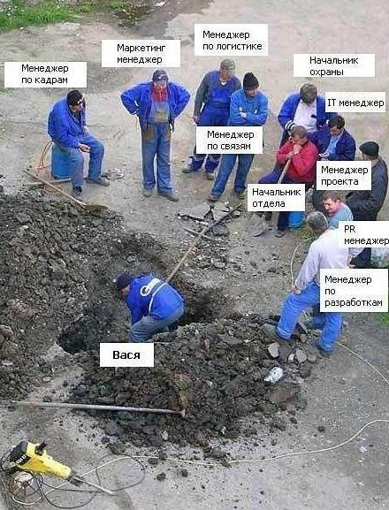
Multithreading

Slide 5
Thread
Thread – a smallest unit of execution that can be scheduled by the operating system.
Process – a group of associated threads that execute in the same, shared environment. The threads in the same process share the same memory space and can communicate directly with one another.
Task - a single unit of work performed by a thread

Slide 6
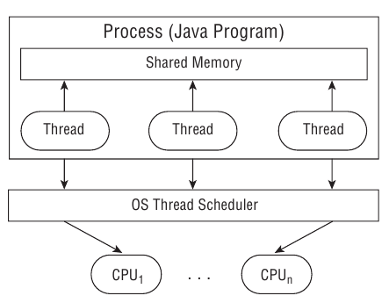
Process model

Slide 7
Thread scheduler and context switch
When a thread’s allotted time is complete but the thread has not finished processing, a context switch occurs. A context switch is the process of storing a thread’s current state and later restoring the state of the thread to continue execution. Often a cost associated with a context switch by way of lost time saving and reloading a thread’s state.
Thread can interrupt or supersede another thread with lower priority (minimum 1 and maximum 10)

Slide 8
Thread types
System - created by the JVM and runs in the background of the application (GC).
User-defined - one created by the application developer to accomplish a specific task.
Daemon - one that will not prevent the JVM from exiting when the program finishes. Both system and user-defined threads can be marked as daemon threads

Slide 9
Main Thread
Created automatically on program start
public static void main(String args[]) { Thread thread = Thread.currentThread(); // ... }

Slide 10
Runnable
The Runnable interface is commonly used to define the work a thread will execute, separate from the main application thread
@FunctionalInterface public interface Runnable { void run(); }
Runnable r1 = () -> System.out.println("Hello World"); Runnable r2 = () -> {int i=10; i++;}; Runnable r3 = () -> {return;}; Runnable r4 = () -> {};

Slide 11
Creating a Thread
Define the Thread with the corresponding task (Runnable) to be done by overriding method Runnable::run
Start the task by using the Thread::start() method.
Java does not provide any guarantees about the order in which a thread will be processed once it is started.

Slide 12
Defining the task implementing Runnable
class PrintData implements Runnable { @Override public void run() { for (int i = 0; i < 3; i++) { System.out.println("Printing record: " + i);
} } public static void main(String[] args) { new Thread(new PrintData()).start(); } }

Slide 13
Defining the task extending Thread
class PrintData extends Thread { @Override public void run() { for (int i = 0; i < 3; i++) { System.out.println("Printing record: " + i);
} } public static void main(String[] args) { new PrintData().start(); } }

Slide 14
Extend thread vs Implement runnable
If you need own Thread rules upon which multiple tasks will rely, such as a priority Thread, extending Thread may be preferable.
Extending Thread does not allow you to extend any other class, whereas implementing Runnable lets you extend another class.
Implementing Runnable is often a better object-oriented design practice since it separates the task being performed from the Thread object performing it.
Implementing Runnable allows the class to be used by numerous Concurrency API classes.

Slide 15
Callable
Similar to Runnable, but returns a value and can throw a checked exception
@FunctionalInterface public interface Callable<V> { V call() throws Exception; }

Slide 16
Callable
public static void main(String[] args)
throws InterruptedException, ExecutionException
{ ExecutorService service = null; try { service = Executors.newSingleThreadExecutor(); Future<Integer> result = service.submit(() -> 30+11); System.out.println(result.get()); } finally { if(service != null) {
service.shutdown();
} } }

Slide 17
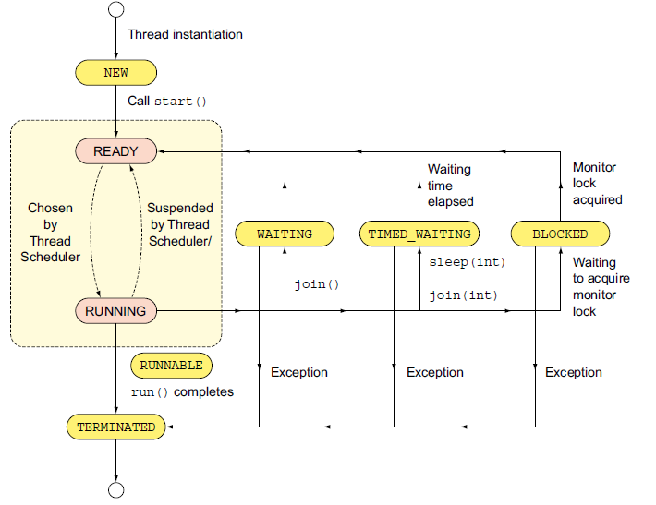
Thread lifecycle

Slide 18
What is the output?
class PrintData extends Thread { @Override public void run() { for (int i = 0; i < 3; i++) System.out.println("Printing record: " + i); } public static void main(String[] args) { new Thread(new PrintData()).run(); new Thread(new PrintData()).run(); new Thread(new PrintData()).run(); } }

Slide 19
What is the output?
class PrintData extends Thread { @Override public void run() { for (int i = 0; i < 3; i++) System.out.println("Printing record: " + i); } public static void main(String[] args) { new Thread(new PrintData()).start(); new Thread(new PrintData()).start(); new Thread(new PrintData()).start(); } }

Slide 20


Synchronizing problem
TrainThread train1 = new TrainThread();
TrainThread train2 = new TrainThread();
train1.start();
train2.start();
Could happen when
Write to the same file
Change an object, a variable
etc.

Slide 21
Synchronizing problem
Thread1
Thread2
Thread3
Monitor
Resource

Slide 22
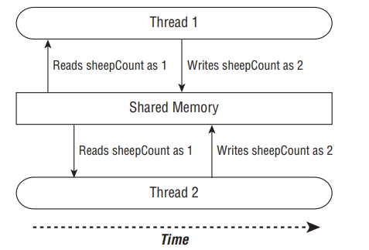
Synchronizing problem

Slide 23
Synchronization problem
Thread 1 (increment) | Thread 2 (decrement)
1: Retrieve c (0) | 2: Retrieve c (0)
3: 0 + 1 = 1 | 4: 0 – 1 = -1
5: Store result; c = 1 | 6: Store result; c = -1
class Counter {
private int c = 0;
public void increment() {
c = c + 1;
}
public void decrement() {
c = c - 1;
}
}

Slide 24
Synchronization problem
class Counter {
private volatile int c = 0;
public synchronized void increment() {
c = c + 1;
}
public synchronized void decrement() {
c = c - 1;
}
}
Thread 1 (increment) | Thread 2 (decrement)
1: Retrieve c (0)
2: 0 + 1 = 1
3: Store result; c = 1
 | 4: Retrieve c (1)
 | 5: 1 – 1 = 0
 | 6: Store result; c = 0

Slide 25
The Volatile Keyword
The Java volatile keyword is used to mark a Java variable as "being stored in main memory". Every read of a volatile variable will be read from the computer's main memory, and not from the CPU cache, and that every write to a volatile variable will be written to main memory, and not just to the CPU cache.
public class SharedObject {
public volatile int counter = 0;
}

Slide 26
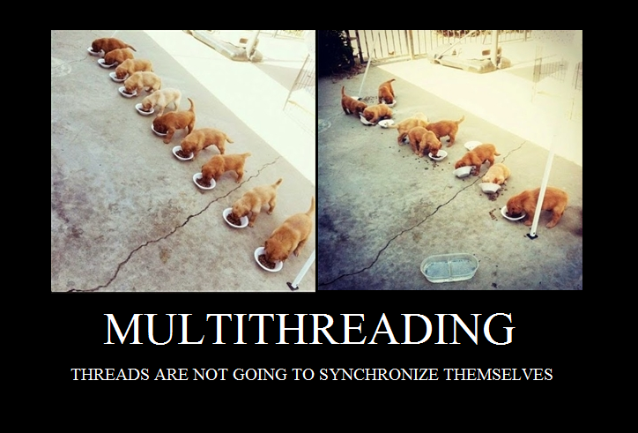
Synchronized Blocks

Slide 27
Synchronized Blocks
A monitor is a structure that supports mutual exclusion or the property that at most one thread is executing a particular segment of code at a given time
PuppyManager manager = new PuppyManager(); synchronized(manager) { // Work to be completed by one thread at a time }

Slide 28
Synchronized
class PuppyManager { private volatile int puppyCount = 0; private void incrementAndReport() { synchronized (this) { System.out.print((++puppyCount) + " "); } } public static void main(String[] args) { ExecutorService service = null; try { service = Executors.newFixedThreadPool(20); PuppyManager manager = new PuppyManager(); for (int i = 0; i < 10; i++) service.submit(manager::incrementAndReport); } finally { if (service != null) service.shutdown(); } } }

Slide 29
Synchronized
class PuppyManager { private volatile int puppyCount = 0;
private synchronized void incrementAndReport() { System.out.print((++ puppyCount ) + " "); }
public static void main(String[] args) { ExecutorService service = null; try { service = Executors.newFixedThreadPool(20); PuppyManager manager = new PuppyManager(); for (int i = 0; i < 10; i++) service.submit(manager::incrementAndReport); } finally { if (service != null) service.shutdown(); } } }

Slide 30
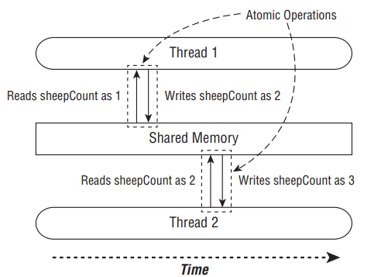
java.util.concurrent.atomic
Atomic is the property of an operation to be carried out as a single unit of execution without any interference by another thread.
Using the atomic classes ensures that the data is consistent between workers and that no values are lost due to concurrent modifications.

Slide 31
java.util.concurrent.atomic
AtomicBoolean
AtomicInteger
AtomicIntegerArray
AtomicLong
AtomicLongArray
AtomicReference
AtomicReferenceArray

Slide 32
Syncronization using atomic (automatically)
class PuppyManager { private AtomicInteger puppyCount = new AtomicInteger(); private void incrementAndReport() { System.out.print((puppyCount.incrementAndGet()) + " "); } public static void main(String[] args) { ExecutorService service = null; try { service = Executors.newFixedThreadPool(20); PuppyManager manager = new PuppyManager(); for (int i = 0; i < 10; i++) service.submit(manager::incrementAndReport); } finally { if (service != null) service.shutdown(); } } }

Slide 33
ExecutorService
ExecutorService service = Executors.newSingleThreadExecutor(); System.out.println("begin"); service.execute(() -> System.out.println("Printing zoo inventory")); service.execute(() -> {
for(int i=0; i<3; i++) System.out.println("Printing record: "+i);
}); service.execute(() -> System.out.println("Printing zoo inventory")); System.out.println("end");
begin
Printing zoo inventory
Printing record: 0
Printing record: 1
end
Printing record: 2
Printing zoo inventory

Slide 34
Submit vs Execute
void execute(Runnable command) – returns nothing, “fire-and-forget”
Future<?> submit(Runnable task) - returns a Future object, allows Callable

Slide 35
Future - Waiting for Results
Future future = service.submit(() -> System.out.println("Hello Zoo"));
boolean isDone() - returns true if the task was completed, throw an exception, or was cancelled.
boolean isCancelled()- returns true if the task was cancelled before it completely normally.
boolean cancel() - attempts to cancel execution of the task.
V get() - retrieves the result of a task, waiting endlessly if it is not yet available.
V get(long timeout, TimeUnit unit) - retrieves the result of a task, waiting the specified amount of time. If the result is not ready by the time the timeout is reached, a checked TimeoutException will be thrown.

Slide 36

Future::get

Slide 37
ExecutorService shutdown
ExecutorService service = null; try { service = Executors.newFixedThreadPool(3); System.out.println("before submit"); Future<Integer> result = service.submit(new Factorial(10)); System.out.println("after submit"); System.out.println(result.get()); System.out.println("after result"); } catch (InterruptedException | ExecutionException e) { throw new RuntimeException(“Execution failed", e); } finally { if (service != null) { service.shutdown(); } }
class Factorial implements Callable<Integer>{ private int n; public Factorial(int n) { this.n = n; } @Override public Integer call(){ return IntStream.rangeClosed(1, n).reduce(1, (n1, n2) -> n1 * n2); } }

Slide 38
Scheduling Tasks
ScheduledExecutorService service = Executors.newSingleThreadScheduledExecutor();
schedule(Callable callable, long delay, TimeUnit unit) - Creates and executes a Callable task after the given delay
schedule(Runnable command, long delay, TimeUnit unit) - Creates and executes a Runnable task after the given delay
scheduleAtFixedRate(Runnable command, long initialDelay, long period, TimeUnit unit) - Creates and executes a Runnable task after the given initial delay, creating a new task every period value that passes.
scheduleAtFixedDelay(Runnable command, long initialDelay, long delay, TimeUnit unit) - Creates and executes a Runnable task after the given initial delay and subsequently with the given delay between the termination of one execution and the commencement of the next

Slide 39
Thread pool creation
A thread pool is a group of pre-instantiated reusable threads that are available to perform a set of arbitrary tasks
Executors.newSingleThreadExecutor()
Executors.newSingleThreadScheduledExecutor()
Executors.newCachedThreadPool()
Executors.newFixedThreadPool(int threadsCount)
Executors.newScheduledThreadPool(int threadsCount)

Slide 40
Concurrent Collections
public class ZooManager { private Map<String, Object> foodData = new HashMap<String, Object>(); public synchronized void put(String key, String value) { foodData.put(key, value); } public synchronized Object get(String key) { return foodData.get(key); } }

Slide 41
Concurrent Collections
public class ZooManager { private Map<String, Object> foodData = new ConcurrentHashMap<String, Object>(); public void put(String key, String value) { foodData.put(key, value); } public Object get(String key) { return foodData.get(key); } }

Slide 42

Deadlock
Thread1
synchronized
Thread2
synchronized
synchronized
synchronized

Slide 43
Deadlock example
class A { synchronized void methodA(B b) { b.doSomething(); } synchronized void doSomething() { ...} } class B { synchronized void methodB(A a) { a.doSomething(); } synchronized void doSomething() { ...} }

Slide 44
Homework
Optimize analytics calculation. Create a 5-minutes thread-safe cache for results. Caffeine or Guava libraries are not allowed, write own solution. When API is invoked - try to get analytic results from cache, if the value is missing – invoke calculation. Do not forget to actualize/invalidate cache on each students list modification;
Add an API returning full AnalyticsDto containing all statistic info. Parallelize calculation of analytics scores to make it faster. Calculate each rating in a separate thread, apply an Executors framework.
Add scheduled students poll from file in user home directory. Skip already existing students

Slide 45
Useful links
Concurrency (by Baeldung)
Concurrency (by Oracle)
Concurrency (by HowToDoInJava)

Slide 46
Thanks!
Any Questions?
Or find us in Slack:
@Yaroslav Brahinets
@Vasya Rudas

